Slide 1

PROJECT ON: FIFA FOOTBALL WORLD CUP DATABASE MANAGEMENT SYSTEM
AMERICAN INTERNATIONAL UNIVERSITY-BANGLADESH
DEPARTMENT OF COMPUTER SCIENCE
FALL 2022-23
COURSE: INTRODUCTION TO DATABASE
SECTION: C
COURSE FACULTY: MST. TASNIM PARVEEN

Slide 2
CONTENTS:
INTRODUCTION
SCENERIO
ER DIAGRAM
TABLE CREATION
DATA INSERTION
QUERY
CONCLUSION

Slide 3
INTRODUCTION:
The main objective of this database project is to create a database to centrally handle a Database Management System based on FIFA Football World Cup Management. The database can provide various information about the teams or matters within the teams such as players or coaches of the World cup. Others matters such as matches, referee, stadium can be found also. This database consists of ten entities.

Slide 4
SCENARIO DESCRIPTION:
A FIFA Football World Cup management system contains Team. Team is uniquely identified by TEAM ID. Other attributes of a Team are TEAM NAME, RANK. A team has a Team_Stats. Team_Stats is also identified by TEAM ID Team_Stats has MATCH PLAYED, WIN, LOSS, DRAW. A Team plays many Matches. A Match is identified by MATCH ID. A Match also has TEAM 1 NAME, TEAM 2 NAME, WINNER, LOSSER, MATCH DATE, STADIUM ID, REFEREE ID. Many Matches are held in many Stadiums. A Stadium has unique STADIUM ID. Stadium also has STADIUM NAME, LOCATION, TOTAL MATCHES, CAPACITY. One Match is maintained by one Referee. Referee has unique REFEREE ID as primary key. Referee also has REFEREE NAME, AGE, N/O MATCHES, COUNTRY. One Team is maintained by one Coach. Coach is identified by COACH ID. Coach also has TEAM ID and COACH NAME. One Team contains many players. Player is identified by unique PLAYER ID. Player also has PLAYER NAME, TEAM ID, AGE and JERSEY NUMBER. A team also is captained by one Captain. Captain is identified by PLAYER ID. Captain also has TEAM ID, Y/O CAPTAINCY. One Player has one Player Stats. Player Stats is also identified by PLAYER ID. Player_Stats also has TEAM ID, GOALS, ASSIST, MATCH PLAYED, FOUL. A Player can be specialized in many Player Speciality. Player Speciality is also identified by PLAYER ID. Player Speciality also has POSITION and SKILL.

Slide 5
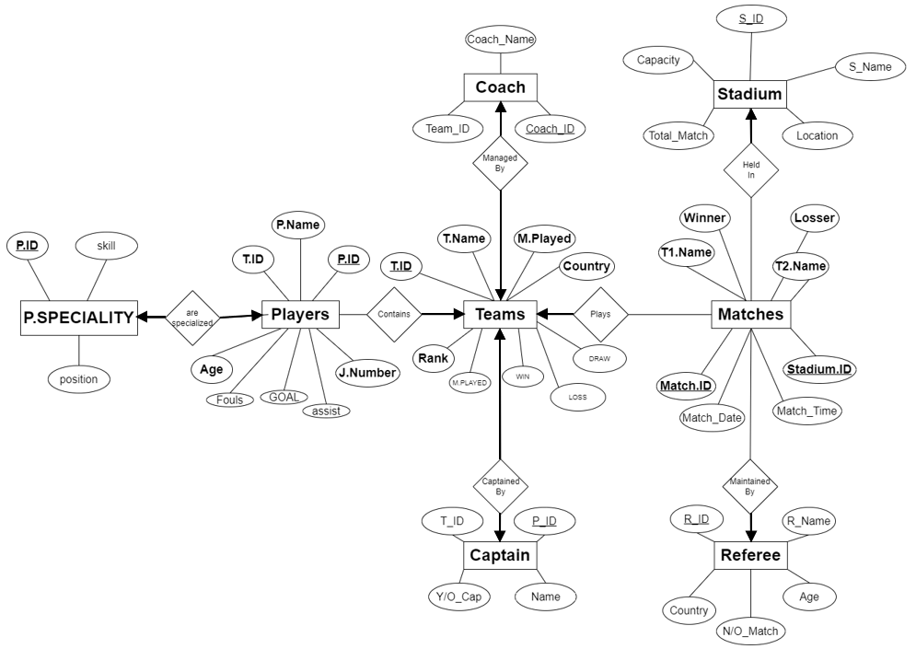
ER DIAGRAM:
BEFORE NORMALIZATION:

Slide 6
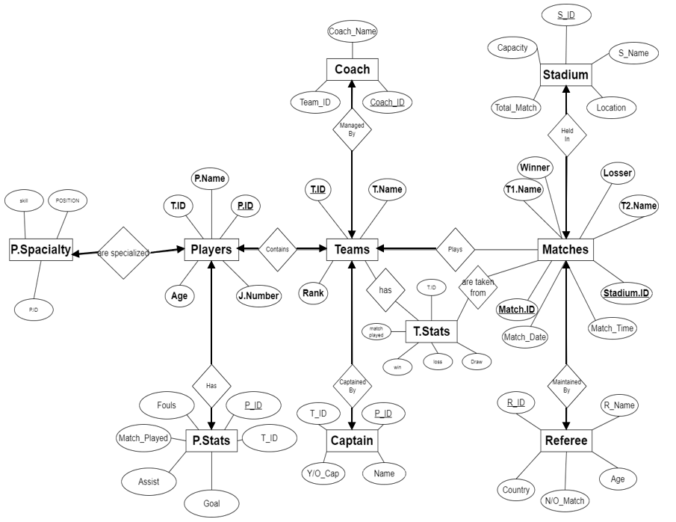
AFTER NORMALIZATION:

Slide 7
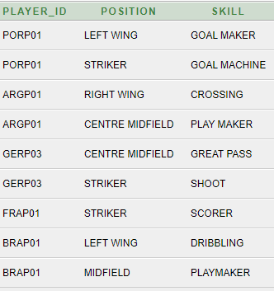
NORMALIZATION:
Player_Speciality TABLE:
1NF
BEFORE 1NF:
AFTER 1NF:
PLAYER_ID | POSITION | SKILL
PORP01 | LEFT WING, STRIKER | GOAL MAKER, GOAL MACHINE
ARGP01 | RIGHT WING, CENTRE MIDFIELD | PLAY MAKER, GREAT PASS
GERPO3 | CENTRE MIDFIELD, STRIKER | GREAT PASS, SHOOT
FRAP01 | STRIKER | SCORER
BRAPO1 | LEFTWING, MIDFIELD | DRIBBLING, PLAYMAKER
2NF AND 3NF are not required on this table

Slide 8
2NF: Before 2NF:
Player Table:
PLAYER _ID | TEAM_ID | PLAYER_ NAME | AGE | MATCH _PLAYED | GOALS | ASSIST | FOULS | JERSEY NUMBER
ARGP01 | ARG01 | MESSI | 35 | 4 | 5 | 2 | 1 | 10
ARGP02 | ARG01 | DI MARIA | 34 | 4 | 2 | 3 | 2 | 11
ARGP03 | ARG01 | DE PAUL | 24 | 4 | 1 | 5 | 3 | 7
ARGP04 | ARG01 | EMI | 30 | 5 | 0 | 2 | 1 | 1
GERP01 | GER01 | MUSIALA | 19 | 4 | 6 | 1 | 0 | 14
GERP02 | GER01 | HERVERTZ | 23 | 4 | 3 | 2 | 4 | 11
GERP03 | GER01 | MULLER | 34 | 6 | 2 | 5 | 2 | 13
BRAP01 | BRA01 | NEYMER | 30 | 4 | 7 | 2 | 1 | 10

Slide 9
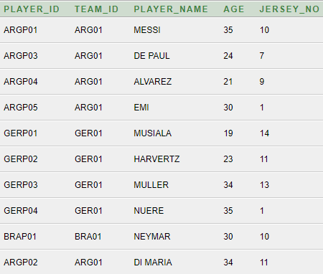
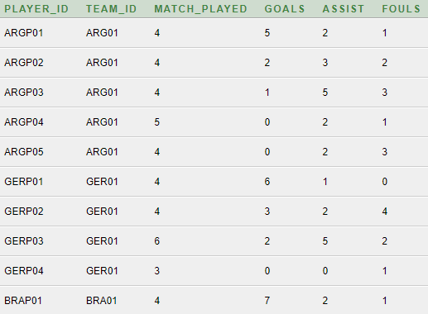
AFTER 2NF:
PLAYER table:
PLAYER_STATS table:
1NF and 3NF are not required on this table

Slide 10
Team TABLE:
BEFORE 2NF:
TEAM_ ID | TEAM_NAME | RANK | MATCH_PLAYED | WINS | LOSS | DRAW
ARG01 | ARGENTINA | 1 | 4 | 3 | 0 | 1
BRA01 | BRAZIL | 3 | 4 | 2 | 1 | 1
GER01 | GERMANY | 2 | 4 | 2 | 1 | 1
POR01 | PORTUGAL | 5 | 4 | 0 | 3 | 1
FRA01 | FRANCE | 4 | 4 | 0 | 3 | 1

Slide 11
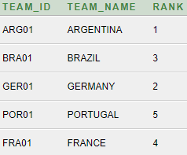
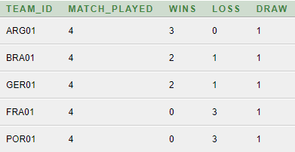
AFTER 2NF:
TEAM table:
TEAM_STATS table:
1NF and 3NF are not required on this table

Slide 12
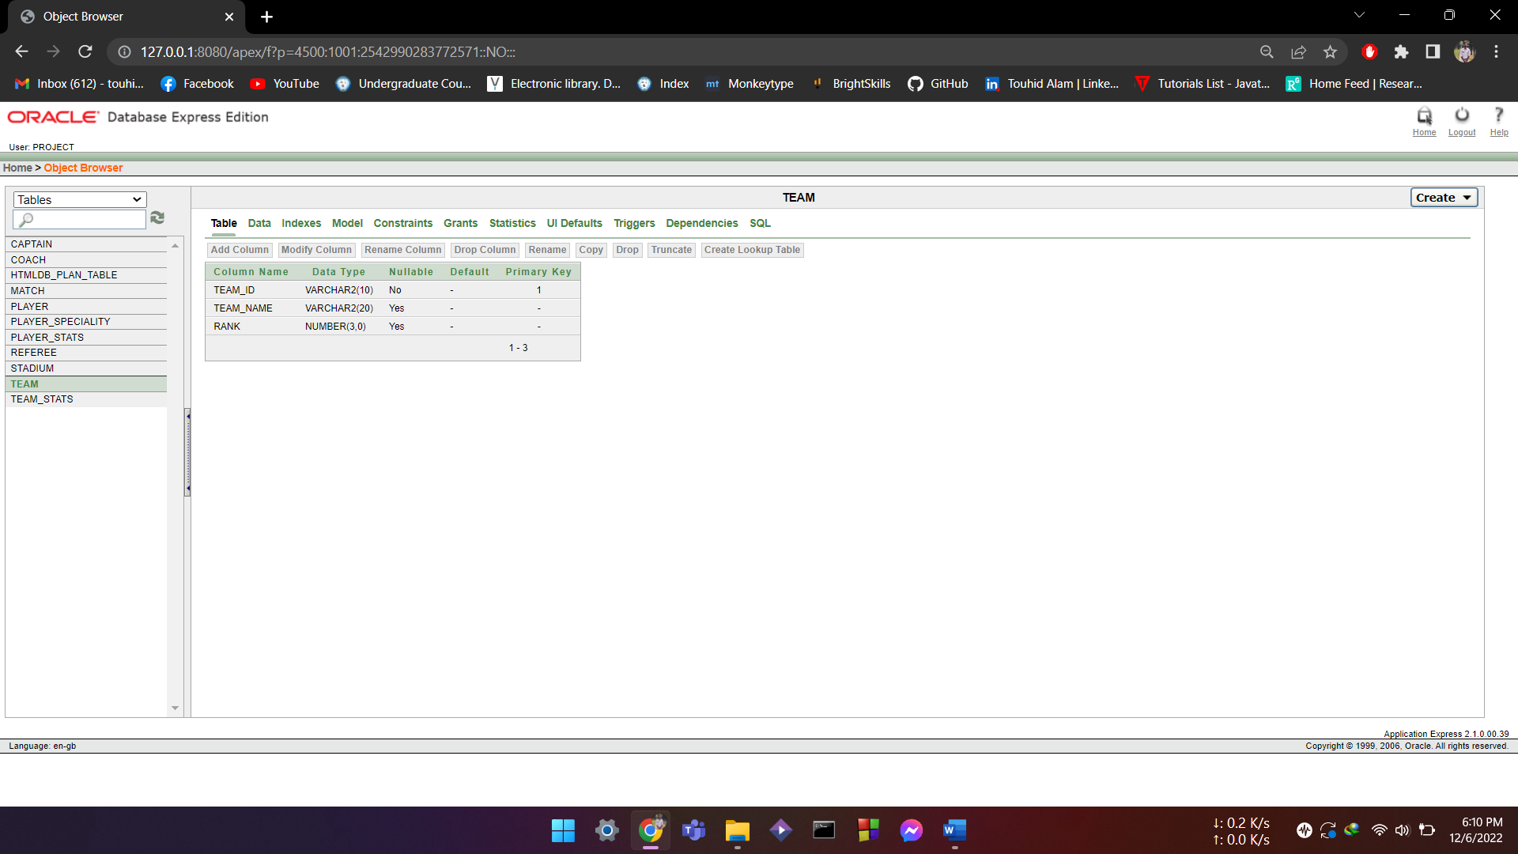
TABLE CREATION:
TEAM:
create table TEAM(
TEAM_ID varchar(10) primary key,
TEAM_NAME varchar(20),
RANK number(3)
);

Slide 13
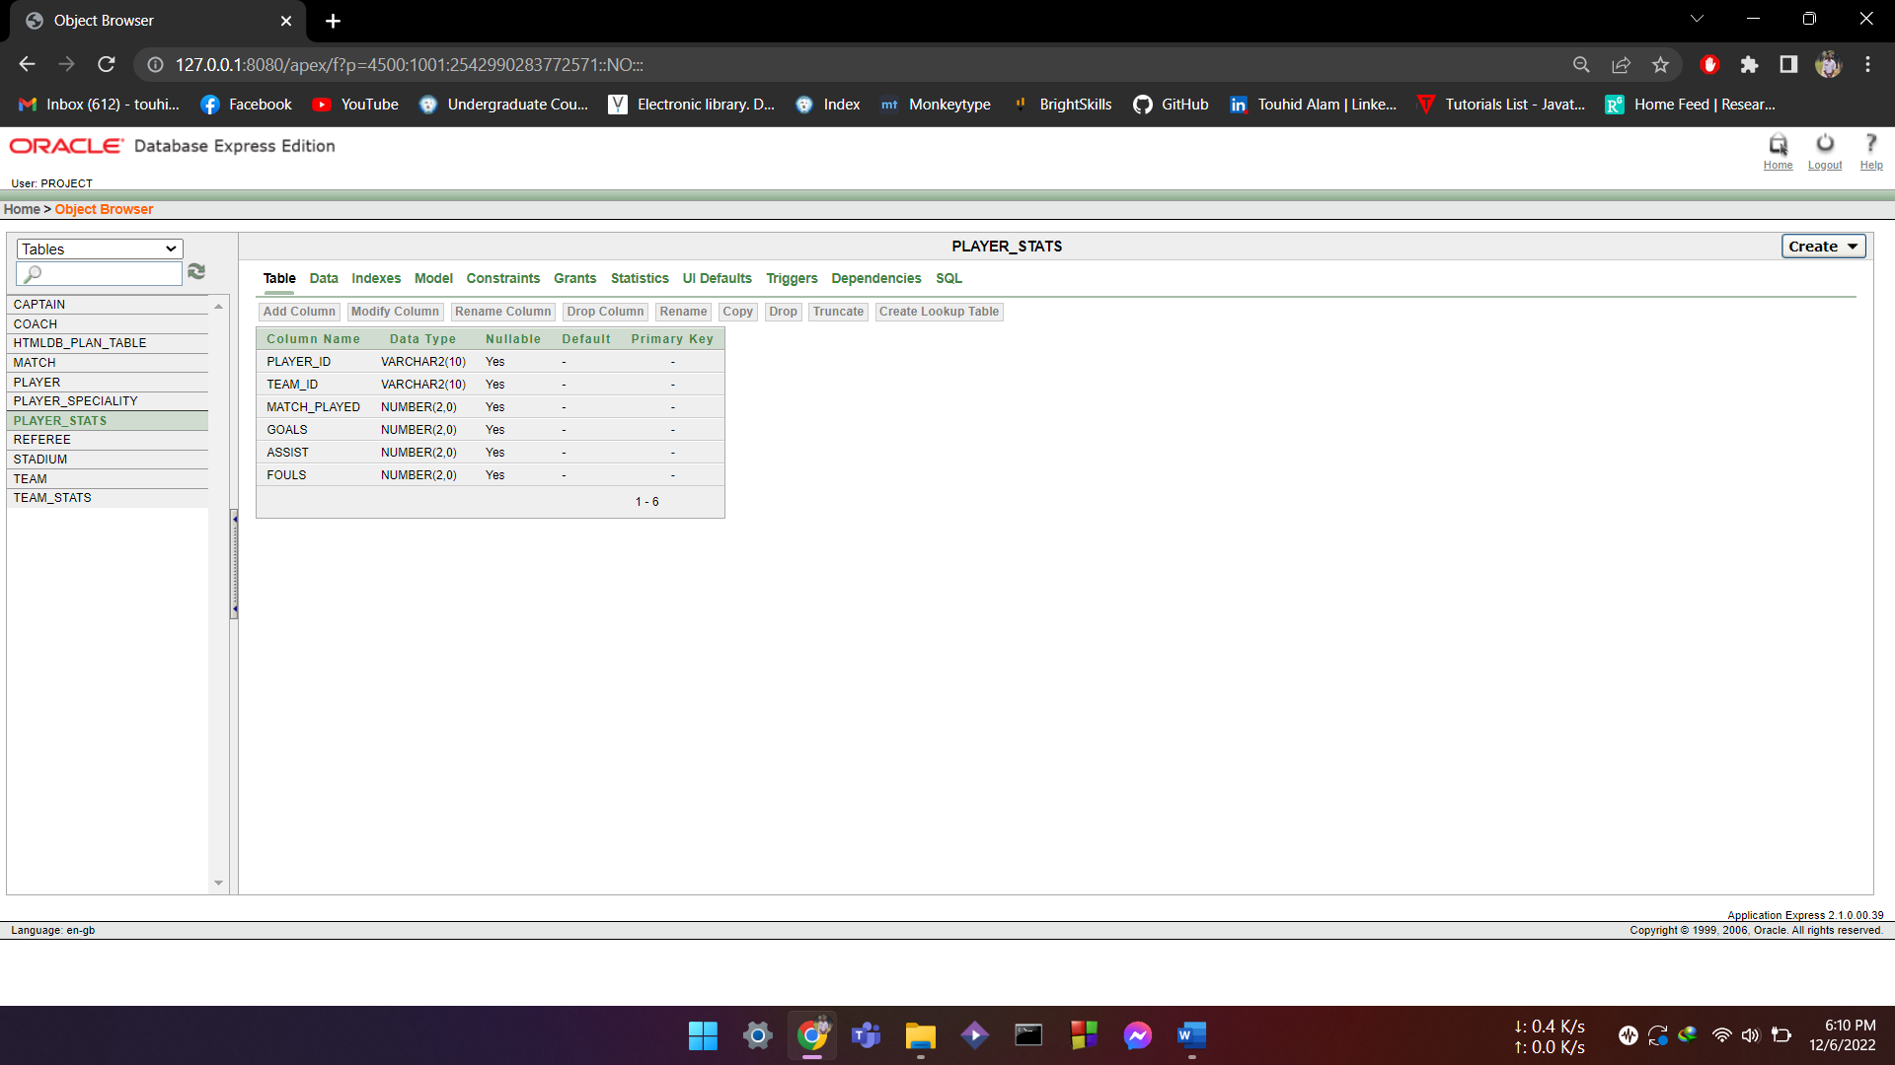
TEAM_STATS:
create table TEAM_STATS(
TEAM_ID references TEAM,
MATCH_PLAYED number(2),
WINS number(2),
LOSS number (2),
DRAW number(2)
);

Slide 14
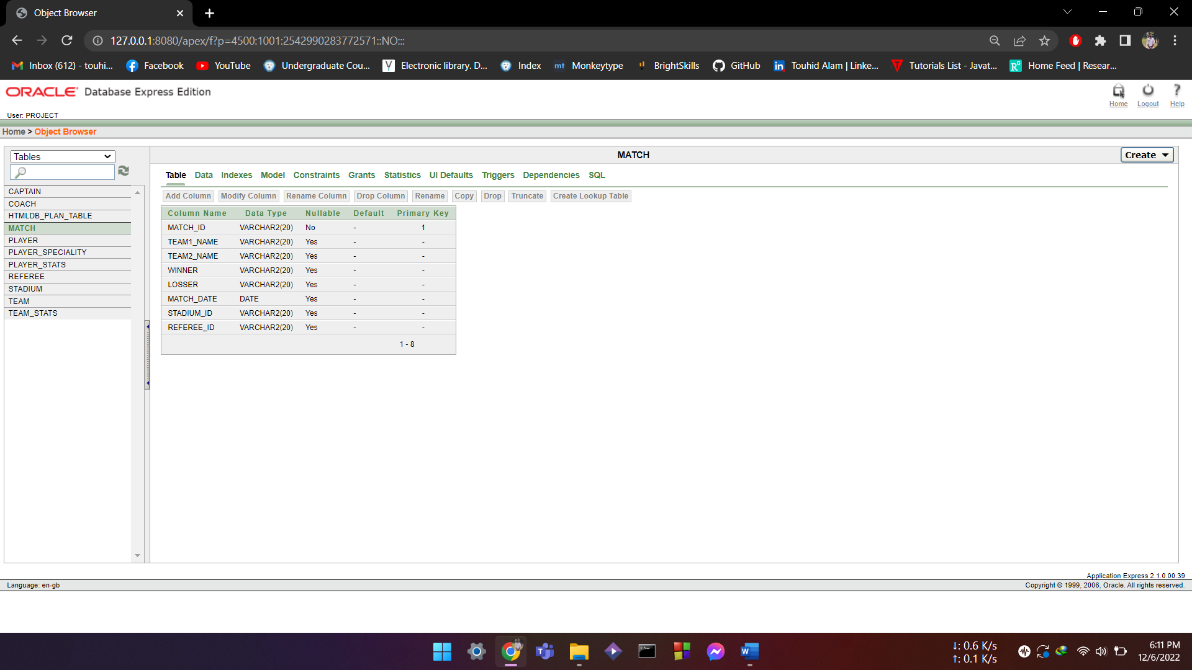
MATCH:
CREATE TABLE MATCH(
MATCH_ID VARCHAR(20) PRIMARY KEY,
TEAM1_NAME VARCHAR(20),
TEAM2_NAME VARCHAR(20),
WINNER VARCHAR(20),
LOSSER VARCHAR(20),
MATCH_DATE DATE,
STADIUM_ID REFERENCES STADIUM,
REFEREE_ID REFERENCES REFEREE
);

Slide 15
REFREE:
create table REFEREE(
REFEREE_ID varchar(20) primary key,
REFEREE_NAME varchar(20),
AGE number(3),
COUNTRY varchar(20),
TOTAL_MATCH number(3));

Slide 16

STADIUM:
create table STADIUM(
STADIUM_ID varchar(20) primary key,
STADIUM_NAME varchar(20),
CAPACITY number(6),
LOCATION varchar(30),
TOTAL_MATCHES number(2)
);

Slide 17
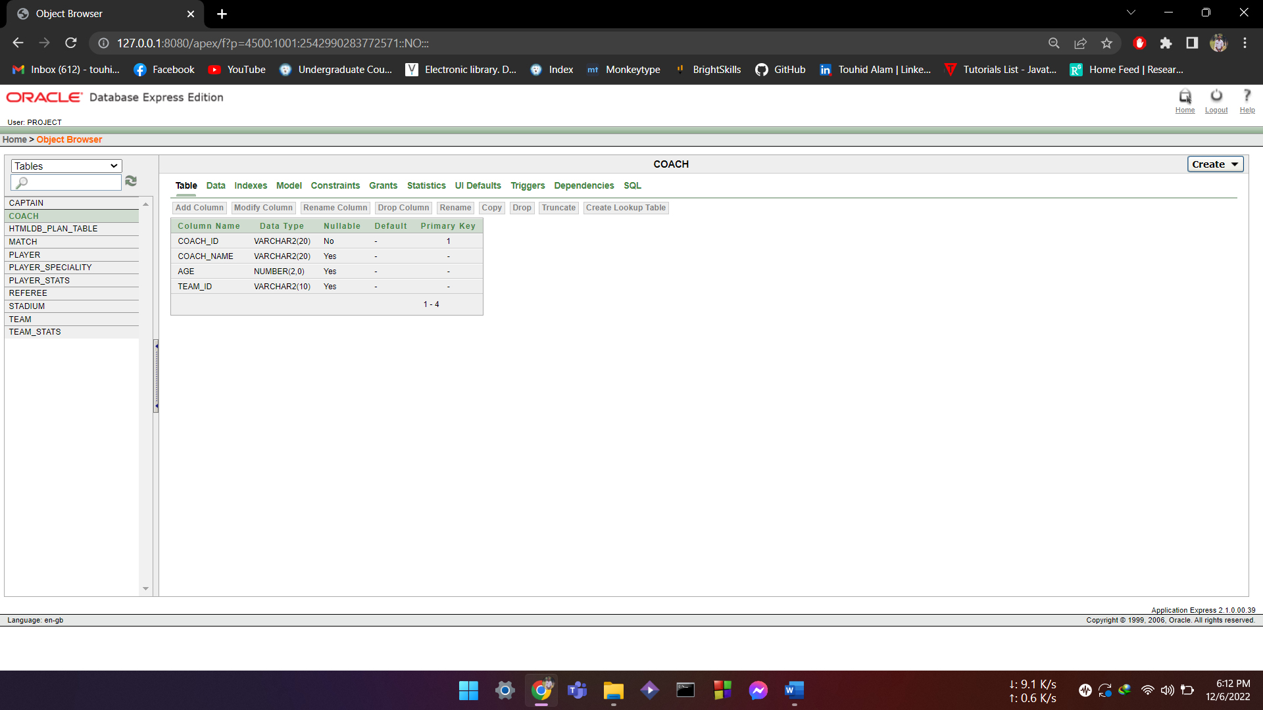
COACH:
create table COACH(
COACH_ID varchar(20) primary key,
COACH_NAME varchar(20),
AGE number(2),
TEAM_ID references TEAM
);

Slide 18
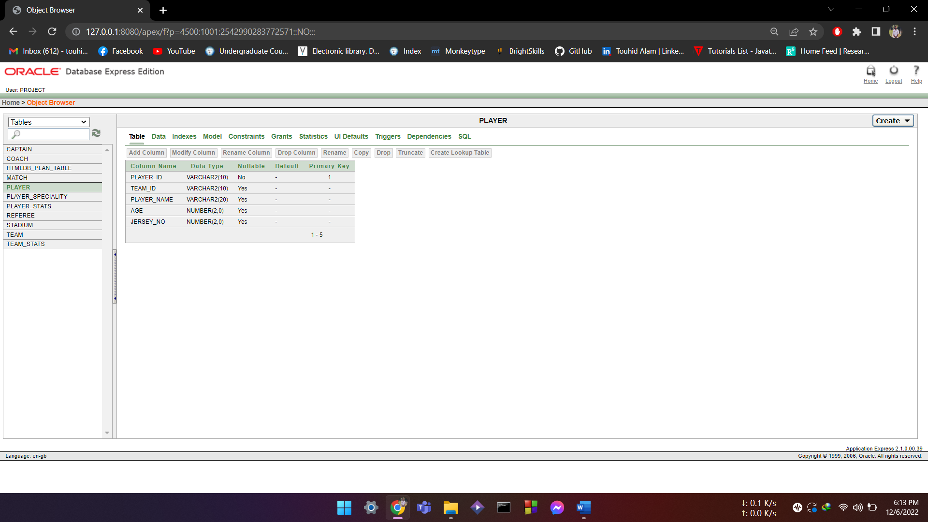
PLAYER:
create table PLAYER(
PLAYER_ID varchar(10) primary key,
TEAM_ID references TEAM,
PLAYER_NAME varchar(20),
AGE number(2),
JERSEY_NO number(2)
);

Slide 19
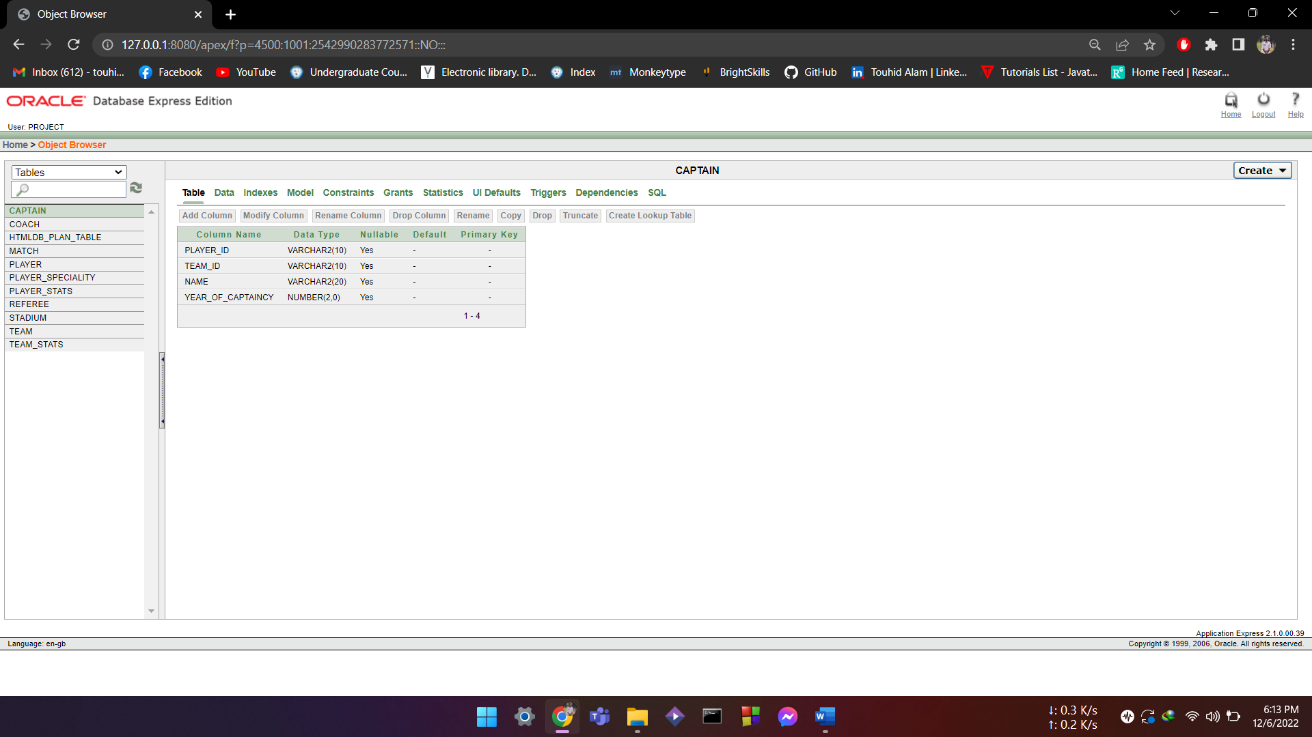
CAPTAIN:
create table CAPTAIN(
PLAYER_ID references PLAYER,
TEAM_ID references TEAM,
NAME varchar(20),
YEAR_OF_CAPTAINCY number(2));

Slide 20

PLAYER_STATS:
create table PLAYER_STATS(
PLAYER_ID REFERENCES PLAYER,
TEAM_ID REFERENCES TEAM,
MATCH_PLAYED NUMBER(2),
GOALS NUMBER(2),
ASSIST NUMBER(2),
FOULS NUMBER(2)
);

Slide 21
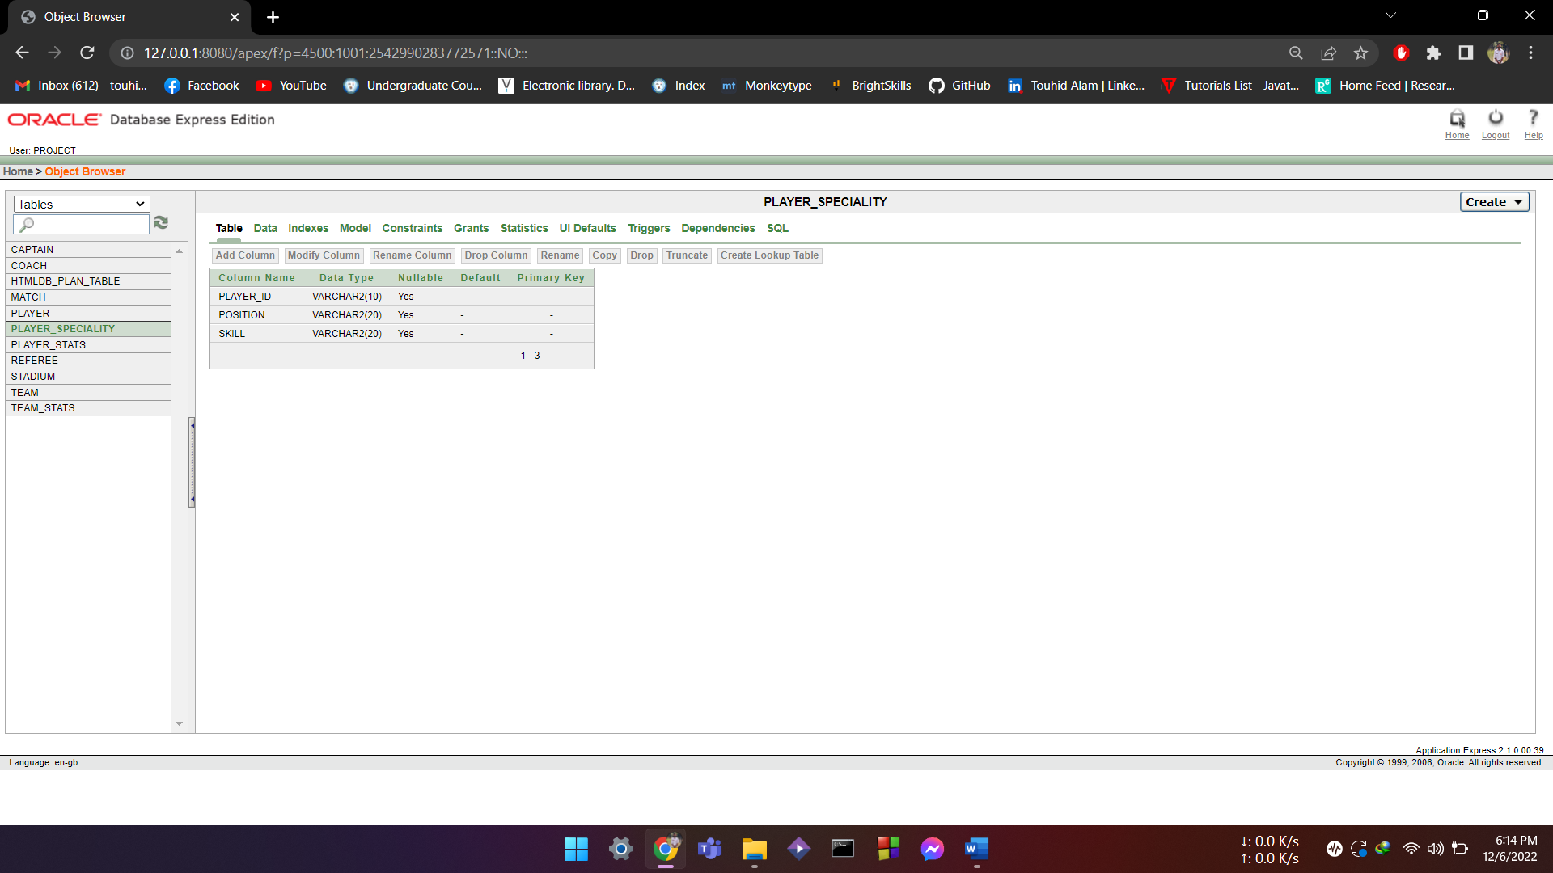
PLAYER_SPECIALITY:
CREATE TABLE PLAYER_SPECIALITY(
PLAYER_ID REFERENCES PLAYER,
POSITION VARCHAR(20),
SKILL VARCHAR(20)
);

Slide 22
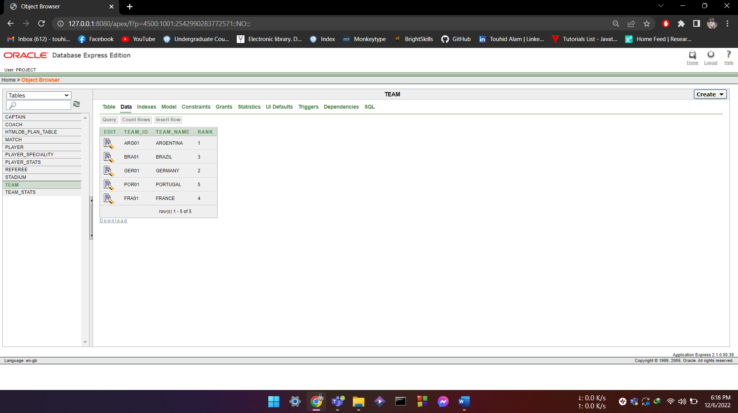
DATA INSERTION:
INSERT INTO TEAM:
INSERT INTO TEAM VALUES(
'BRA01','BRAZIL',3);
INSERT INTO TEAM VALUES(
'ARG01','ARGENTINA',1);
INSERT INTO TEAM VALUES(
'GER01','GERMANY',2);
INSERT INTO TEAM VALUES(
'POR01','PORTUGAL',5);
INSERT INTO TEAM VALUES(
'FRA01','FRANCE',4);

Slide 23
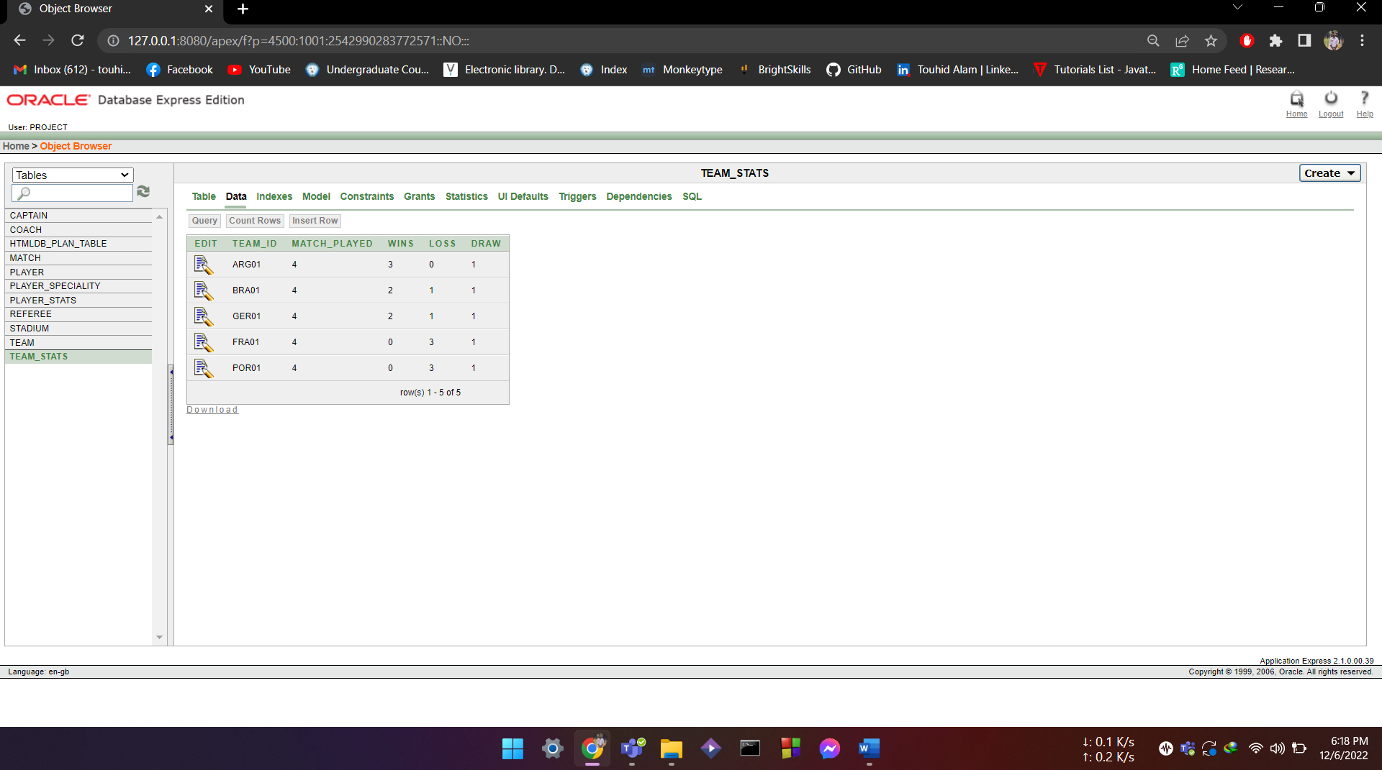
INSERT INTO TEAM_STATS:
insert into TEAM_STATS VALUES(
'ARG01',4,3,0,1);
insert into TEAM_STATS VALUES(
'BRA01',4,2,1,1);
insert into TEAM_STATS VALUES(
'GER01',4,2,1,1);
insert into TEAM_STATS VALUES(
'FRA01',4,0,3,1);
insert into TEAM_STATS VALUES(
'POR01',4,0,3,1);

Slide 24
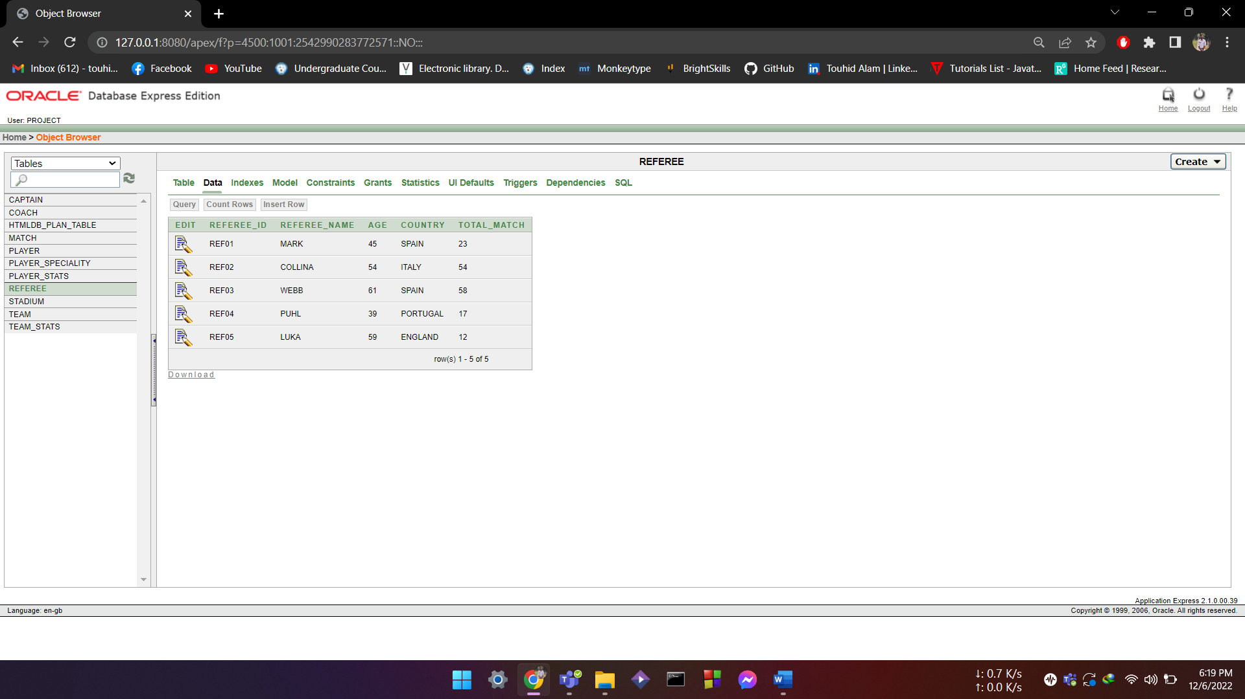
INSERT INTO REFEREE:
INSERT INTO REFEREE VALUES(
'REF01','MARK',45,'SPAIN',23);
INSERT INTO REFEREE VALUES(
'REF02','COLLINA',54,'ITALY',54);
INSERT INTO REFEREE VALUES(
'REF03','WEBB',61,'SPAIN',58);
INSERT INTO REFEREE VALUES(
'REF04','PUHL',39,'PORTUGAL',17)
INSERT INTO REFEREE VALUES(
'REF05','LUKA',59,'ENGLAND',12);

Slide 25
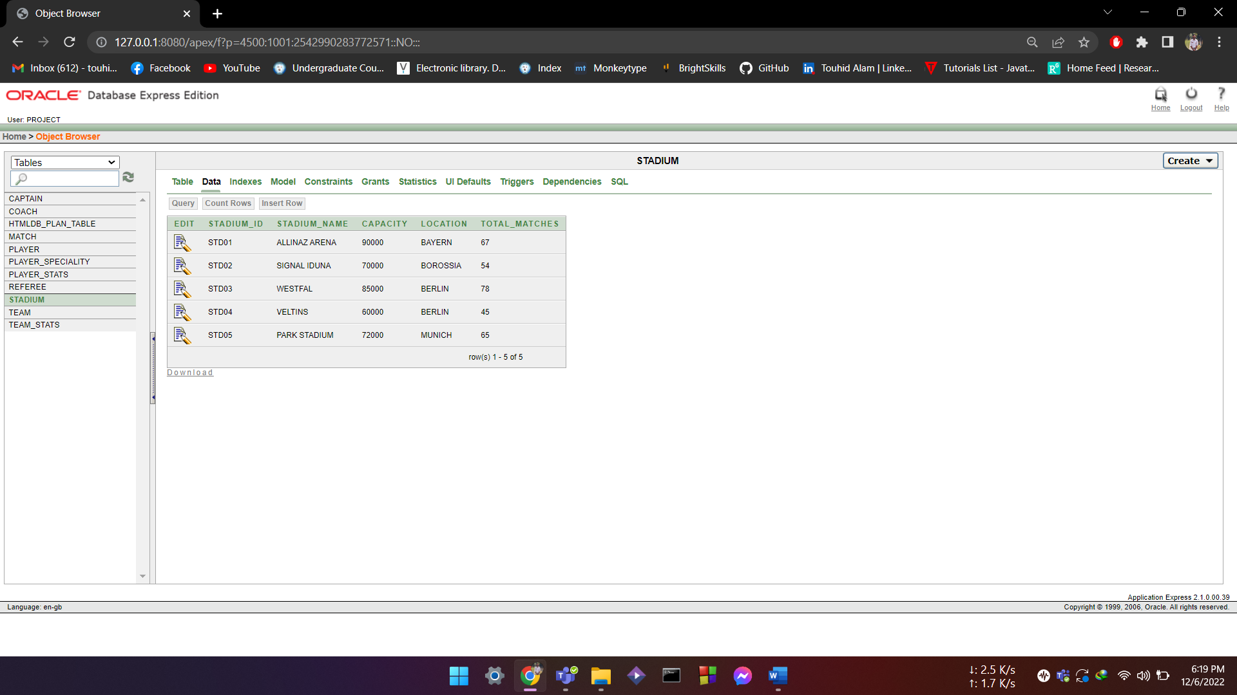
INSERT INTO STADIUM:
INSERT INTO STADIUM VALUES
('STD01','ALLINAZ ARENA',90000,’
BAYERN',67);
INSERT INTO STADIUM VALUES
('STD02','SIGNAL IDUNA',70000,
'BOROSSIA',54);
INSERT INTO STADIUM VALUES
('STD03','WESTFAL',85000,'BERLIN',78);
INSERT INTO STADIUM VALUES
('STD04','VELTINS',60000,'BERLIN',45);
INSERT INTO STADIUM VALUES
('STD05','PARK STADIUM',72000,'MUNICH',65);

Slide 26
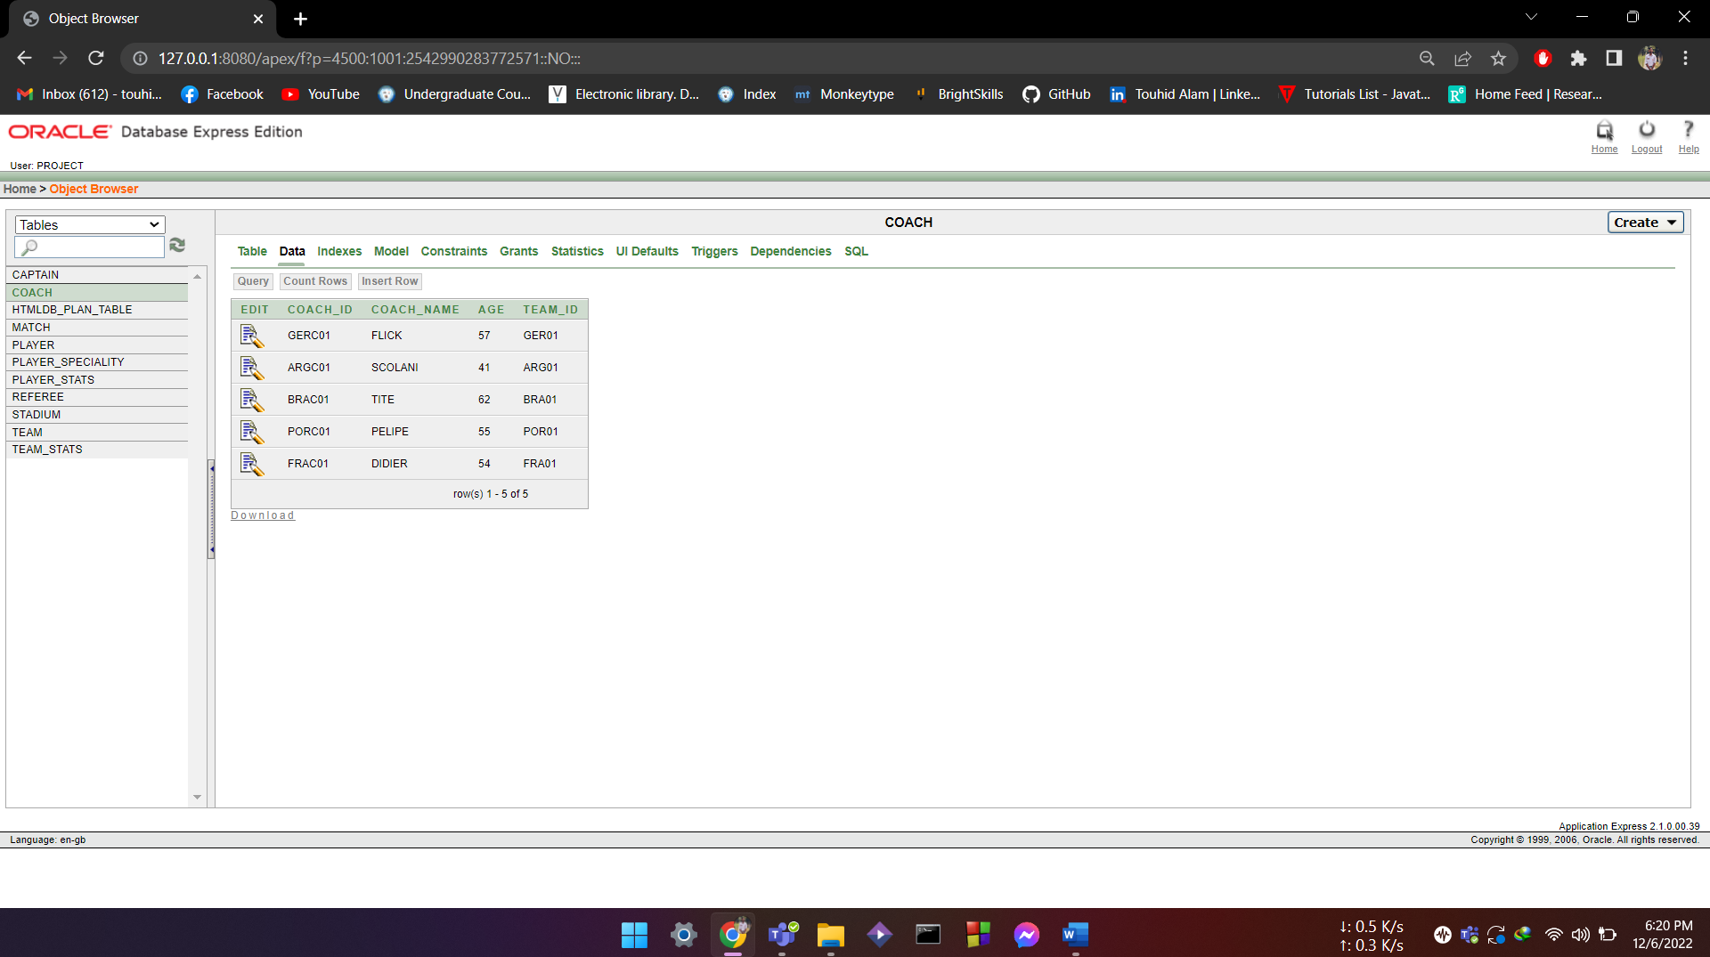
INSERT INTO COACH:
INSERT INTO COACH VALUES(
'GERC01','FLICK',57,'GER01');
INSERT INTO COACH VALUES(
'ARGC01','SCOLANI',41,'ARG01');
INSERT INTO COACH VALUES(
'BRAC01','TITE',62,'BRA01');
INSERT INTO COACH VALUES(
'PORC01','PELIPE',55,'POR01');
INSERT INTO COACH VALUES(
'FRAC01','DIDIER',54,'FRA01');

Slide 27
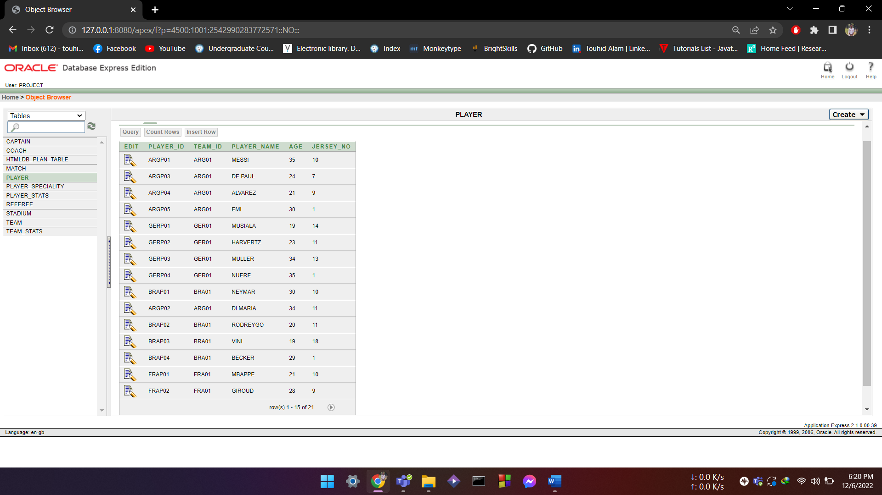
INSERT INTO PLAYER:
INSERT INTO PLAYER VALUES(
'ARGP01','ARG01','MESSI',35,10);
INSERT INTO PLAYER VALUES(
'ARGP02','ARG01','DI MARIA',34,11);
INSERT INTO PLAYER VALUES(
'ARGP03','ARG01','DE PAUL',24,7);
INSERT INTO PLAYER VALUES(
'ARGP04','ARG01','ALVAREZ',21,9);
INSERT INTO PLAYER VALUES(
'ARGP05','ARG01','EMI',30,1);
INSERT INTO PLAYER VALUES(
'GERP01','GER01','MUSIALA',19,14);

Slide 28
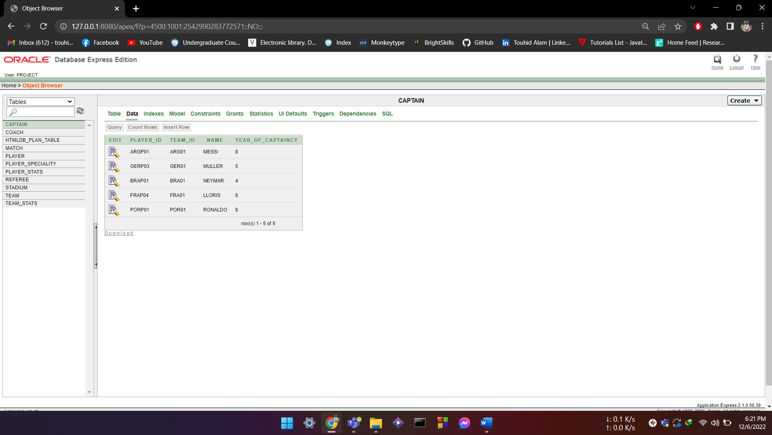
INSERT CAPTAIN:
INSERT INTO CAPTAIN VALUES(
'ARGP01','ARG01','MESSI',8);
INSERT INTO CAPTAIN VALUES(
'GERP03','GER01','MULLER',5);
INSERT INTO CAPTAIN VALUES(
'BRAP01','BRA01','NEYMAR',4);
INSERT INTO CAPTAIN VALUES(
'FRAP04','FRA01','LLORIS',6);

Slide 29
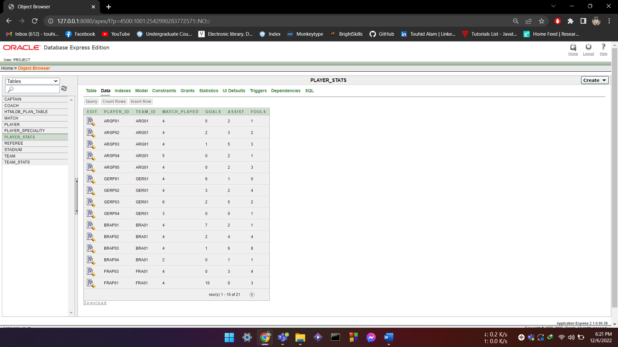
INSERT PLAYER_STATS
INSERT INTO PLAYER_STATS
into PLAYER_STATS VALUES(
'ARGP01','ARG01',04,05,02,01)
insert into PLAYER_STATS VALUES(
'ARGP02','ARG01',04,02,03,02)
insert into PLAYER_STATS VALUES(
'ARGP03','ARG01',04,01,05,03)
insert into PLAYER_STATS VALUES(
'ARGP04','ARG01',05,0,02,01)
insert into PLAYER_STATS VALUES(
'ARGP05','ARG01',04,0,02,03)
insert into PLAYER_STATS VALUES(
'GERP01','GER01',04,06,01,00)

Slide 30
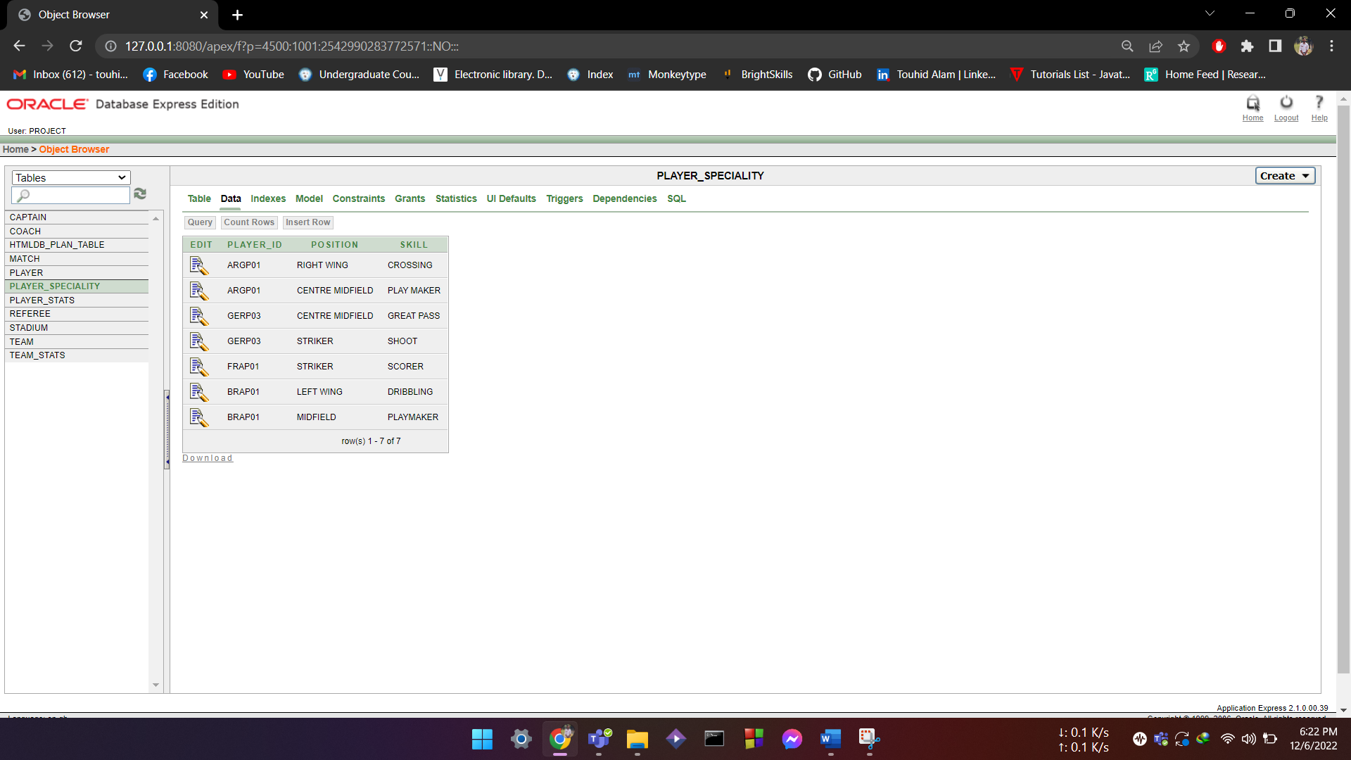
INSERT PLAYER_SPECIALITY:
INSERT INTO PLAYER_SPECIALITY VALUES(
'ARG01','RIGHT WING','CROSSING');
INSERT INTO PLAYER_SPECIALITY VALUES(
'ARGP01','CENTRE MIDFIELD','PLAY MAKER');
INSERT INTO PLAYER_SPECIALITY VALUES(
'GERP03','CENTRE MIDFIELD','GREAT PASS');
INSERT INTO PLAYER_SPECIALITY VALUES(
'GERP03','STRIKER','SHOOT');
INSERT INTO PLAYER_SPECIALITY VALUES(
'FRAP01','STRIKER','SCORER');
INSERT INTO PLAYER_SPECIALITY VALUES(
'BRAP01','LEFT WING','DRIBBLING');

Slide 31
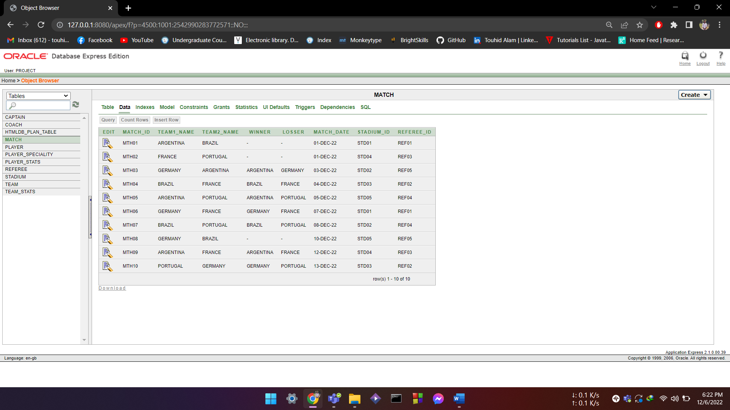
INSERT MATCH:
INSERT INTO MATCH VALUES(
'MTH01','ARGENTINA','BRAZIL','','',TO_DATE('01-12-2022','DD-MM-YYYY'),'STD01','REF01');
INSERT INTO MATCH VALUES(
'MTH02','FRANCE','PORTUGAL','','',TO_DATE('01-12-2022','DD-MM-YYYY'),'STD04','REF03');
INSERT INTO MATCH VALUES(
'MTH03','GERMANY','ARGENTINA','ARGENTINA','GERMANY',TO_DATE('03-12-2022','DD-MM-YYYY'),'STD02','REF05');
INSERT INTO MATCH VALUES(
'MTH04','BRAZIL','FRANCE','BRAZIL','FRANCE',TO_DATE('04-12-2022','DD-MM-YYYY'),'STD03','REF02');

Slide 32
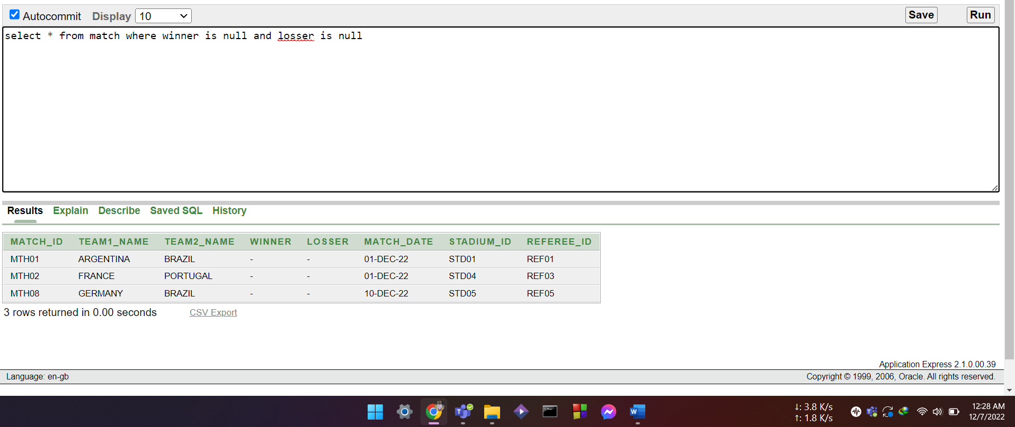
Query design:
Function:
Write a query to show match details with no winners
select * from match where winner is null and losser is null

Slide 33
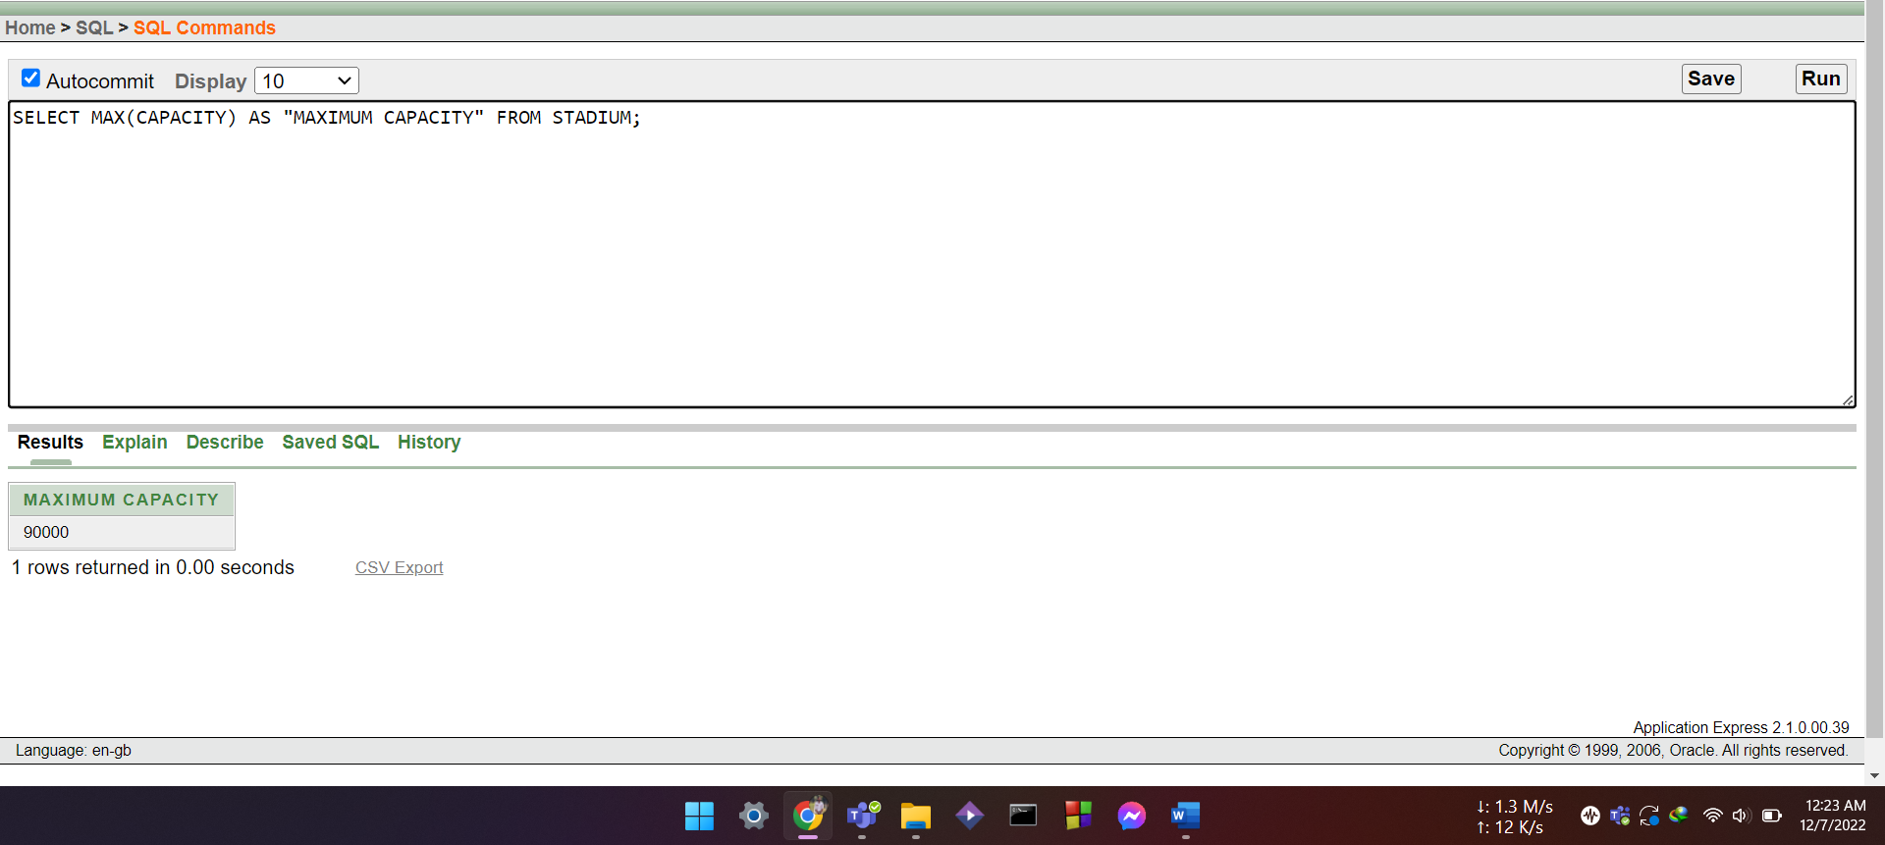
Write a query to show the maximum capacity of stadium as MAX CAPACITY
SELECT MAX(CAPACITY) AS "MAXIMUM CAPACITY" FROM STADIUM;

Slide 34
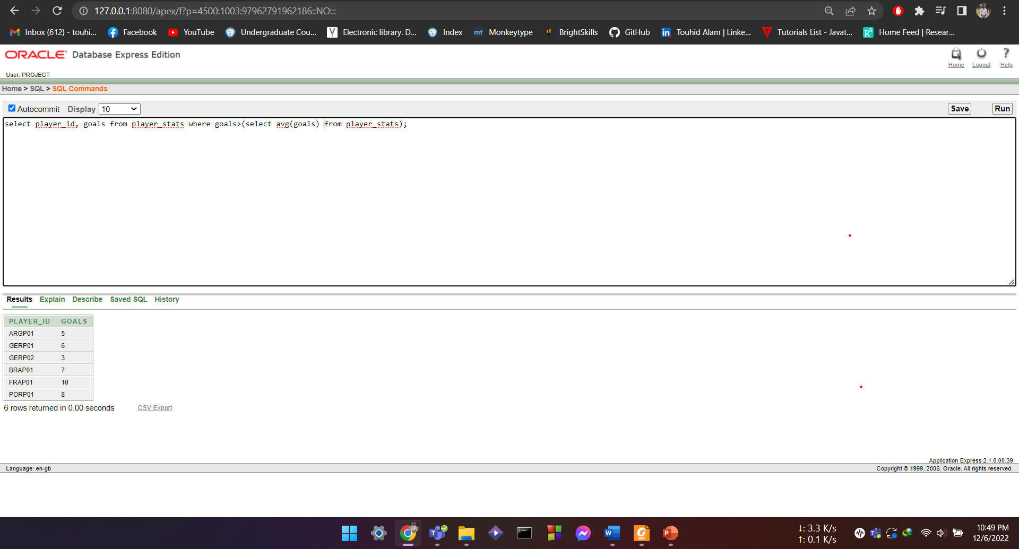
Subquery:
Single Row:
Write a query to show the players who scored more than average goals scored.
select player_id, goals from player_stats where goals>(select avg(goals) from player_stats);

Slide 35
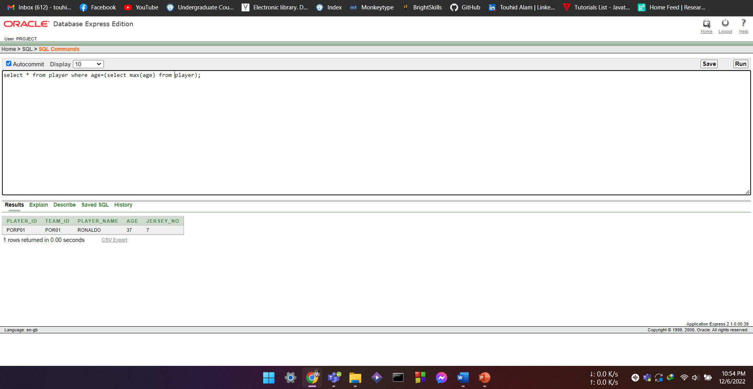
Write a quey to show the details of most aged aged player.
select * from player where age=(select max(age) from player);

Slide 36
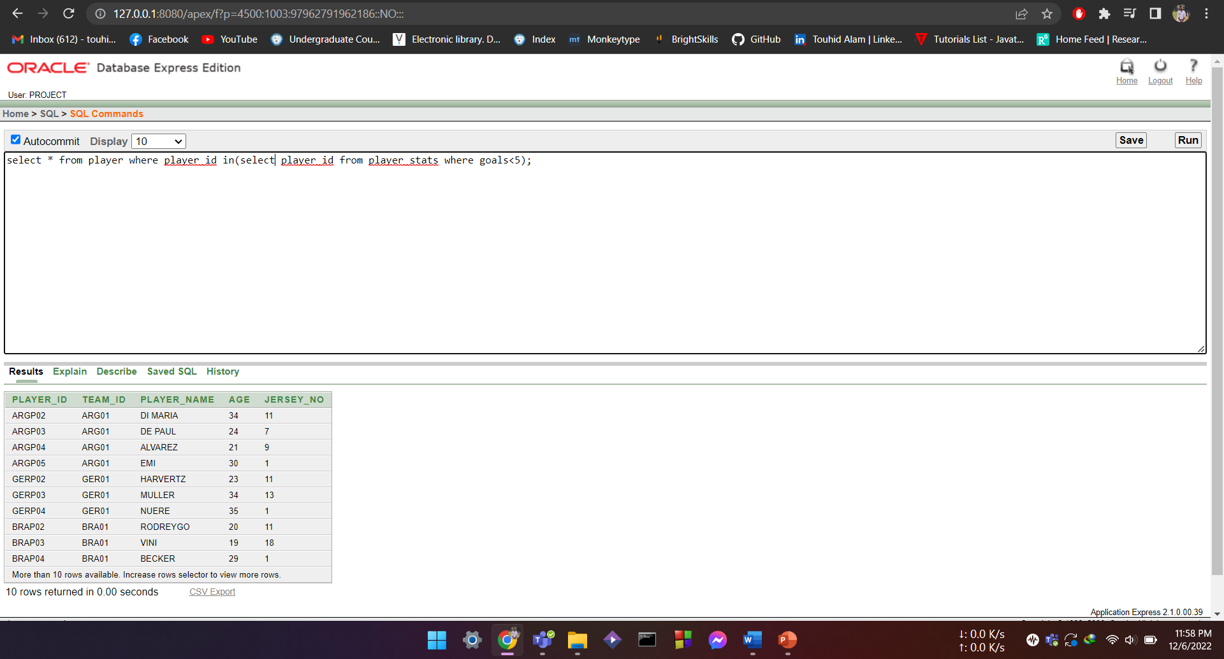
Multiple Row:
Write a query to display information of player who scored less than 5 goals;
select * from player where player_id in(select player_id from player_stats where goals<5);

Slide 37
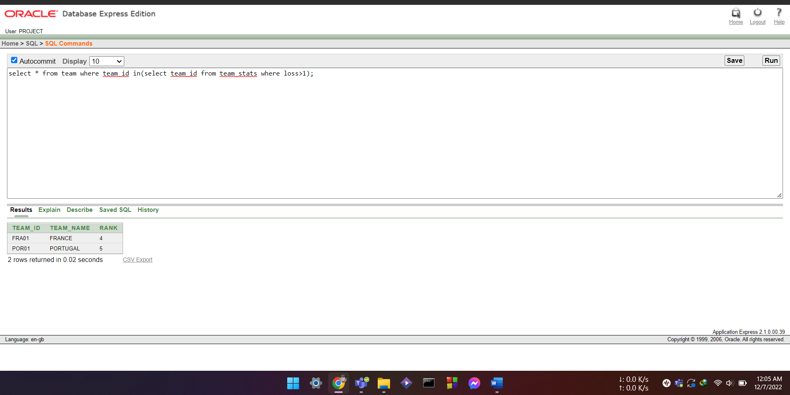
Write a query to display the team information who lost more than one match
select * from team where team_id in(select team_id from team_stats where loss>1);

Slide 38
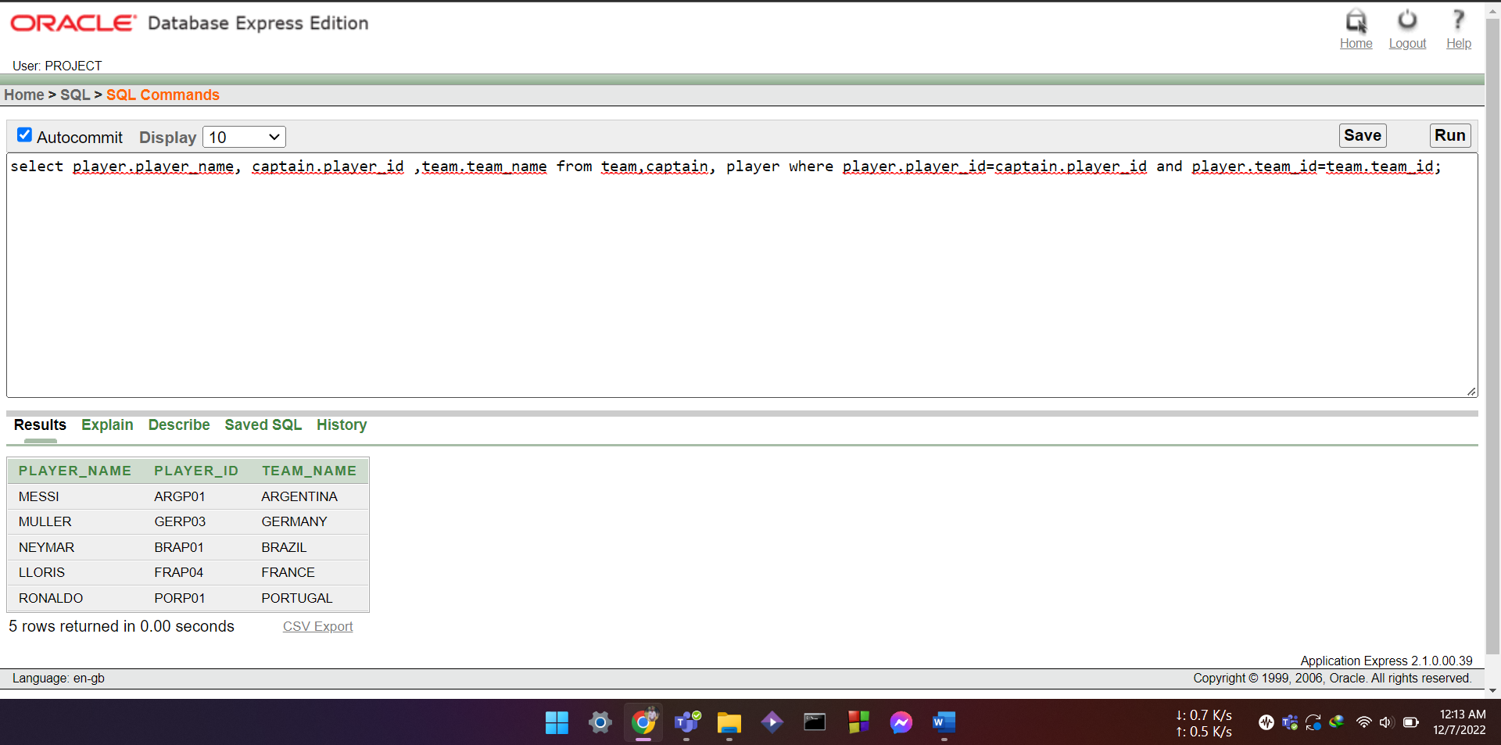
Joining:
Equi-joining:
Write a query to show the captain name, captain id and team name;
select player.player_name, captain.player_id ,team.team_name from team,captain, player where player.player_id=captain.player_id and player.team_id=team.team_id;

Slide 39
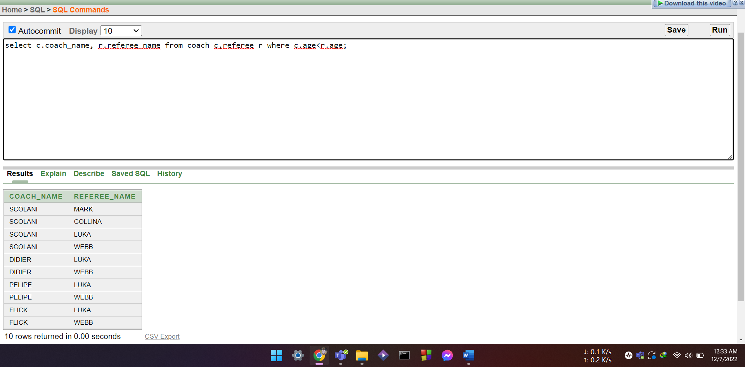
Outer-joining:
Write a query to show the name of coaches and referee older than the coaches
select c.coach_name, r.referee_name from coach c,referee r where c.age<r.age;

Slide 40
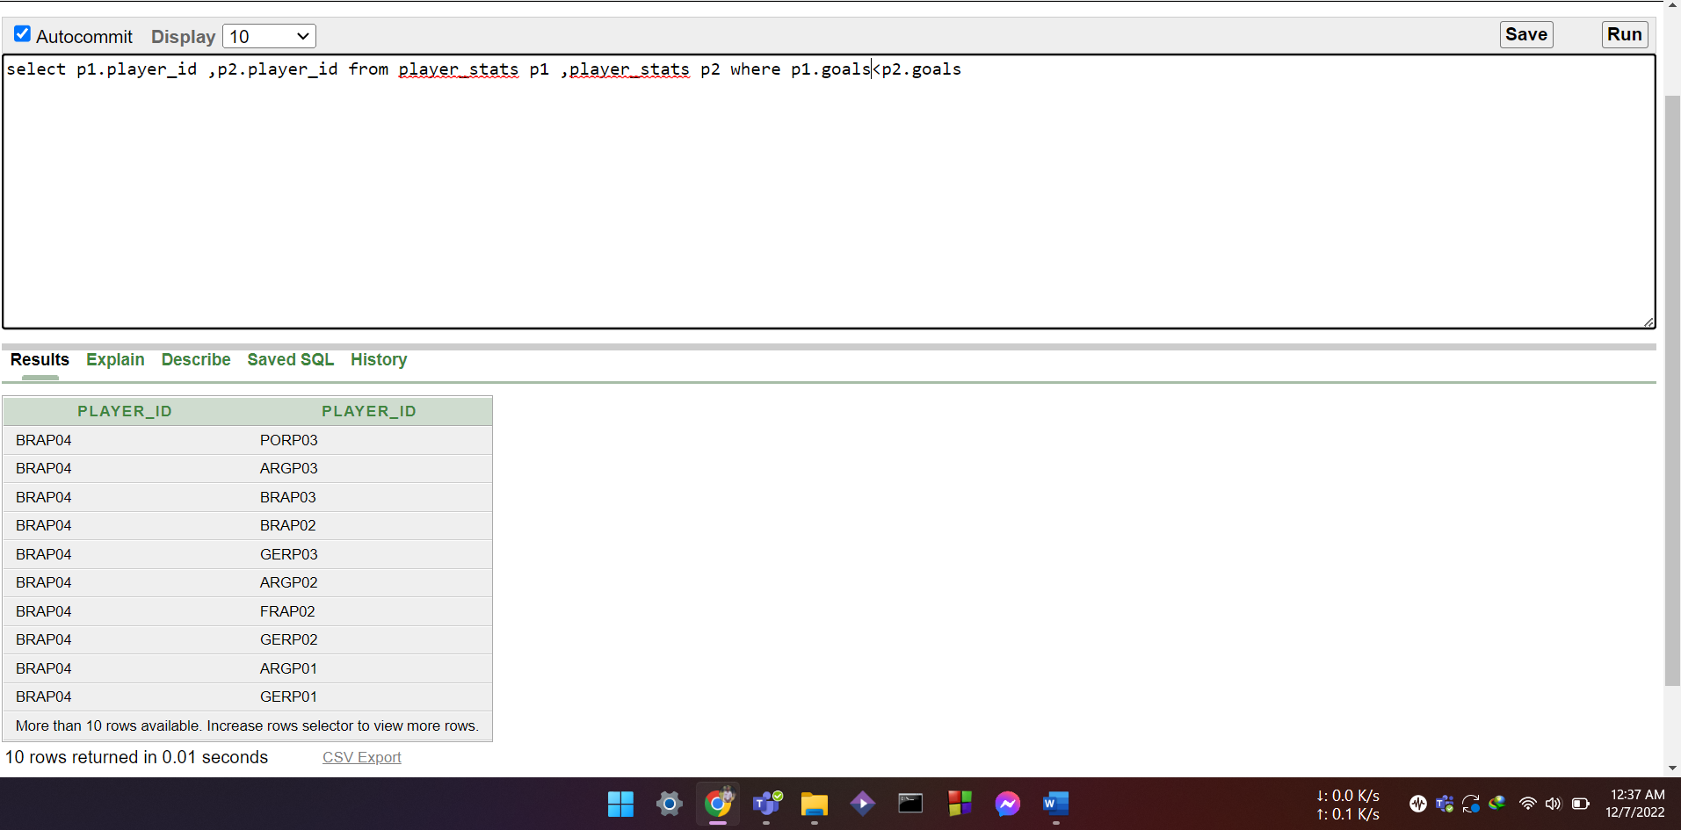
Self-joining:
Write a query to show two player_id where first scored less than other player.
Select p1.player_id , p2.player_id from player_stats p1, player_stats p2 where p1.goals<p2.goals

Slide 41
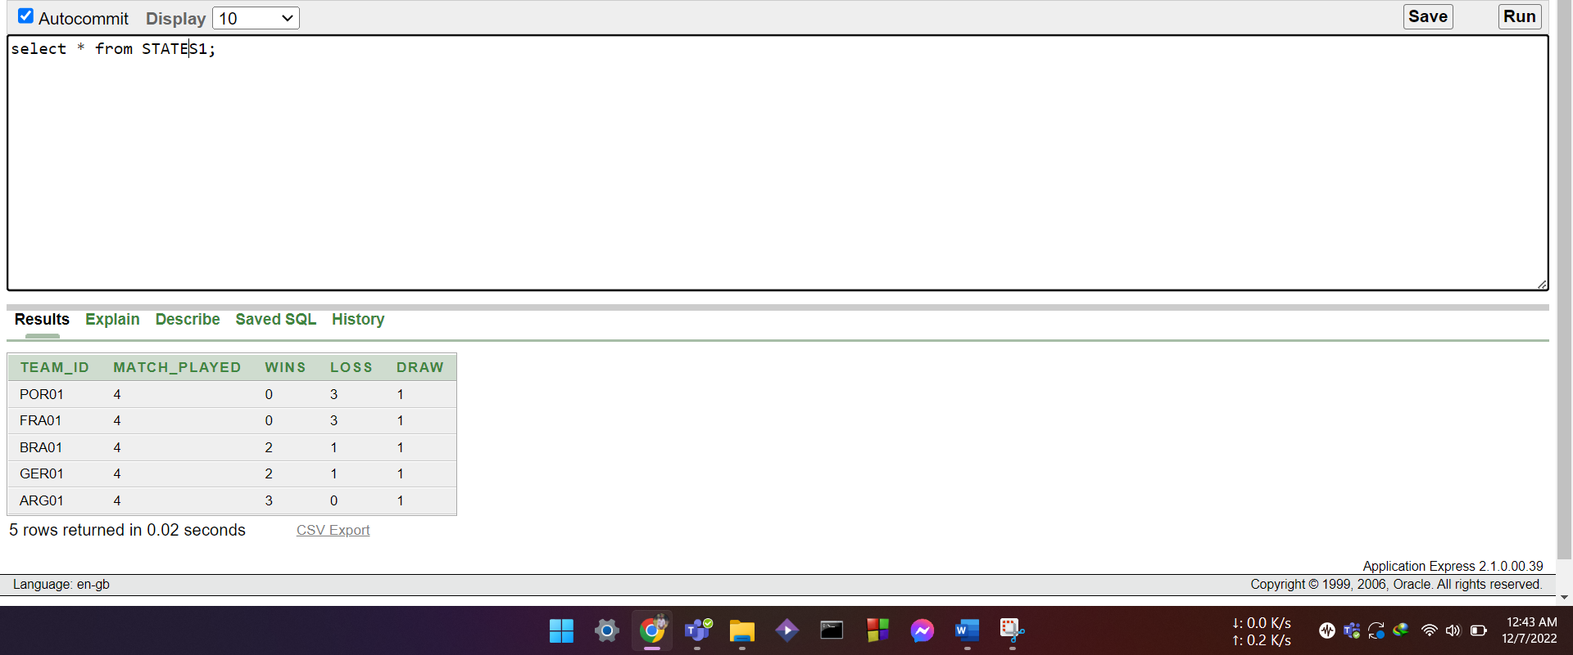
View:
Simple view:
Create a view STATES1 of team stats order by their wins from lowest to highest
create view STATES1 as select * from team_stats order by wins;

Slide 42
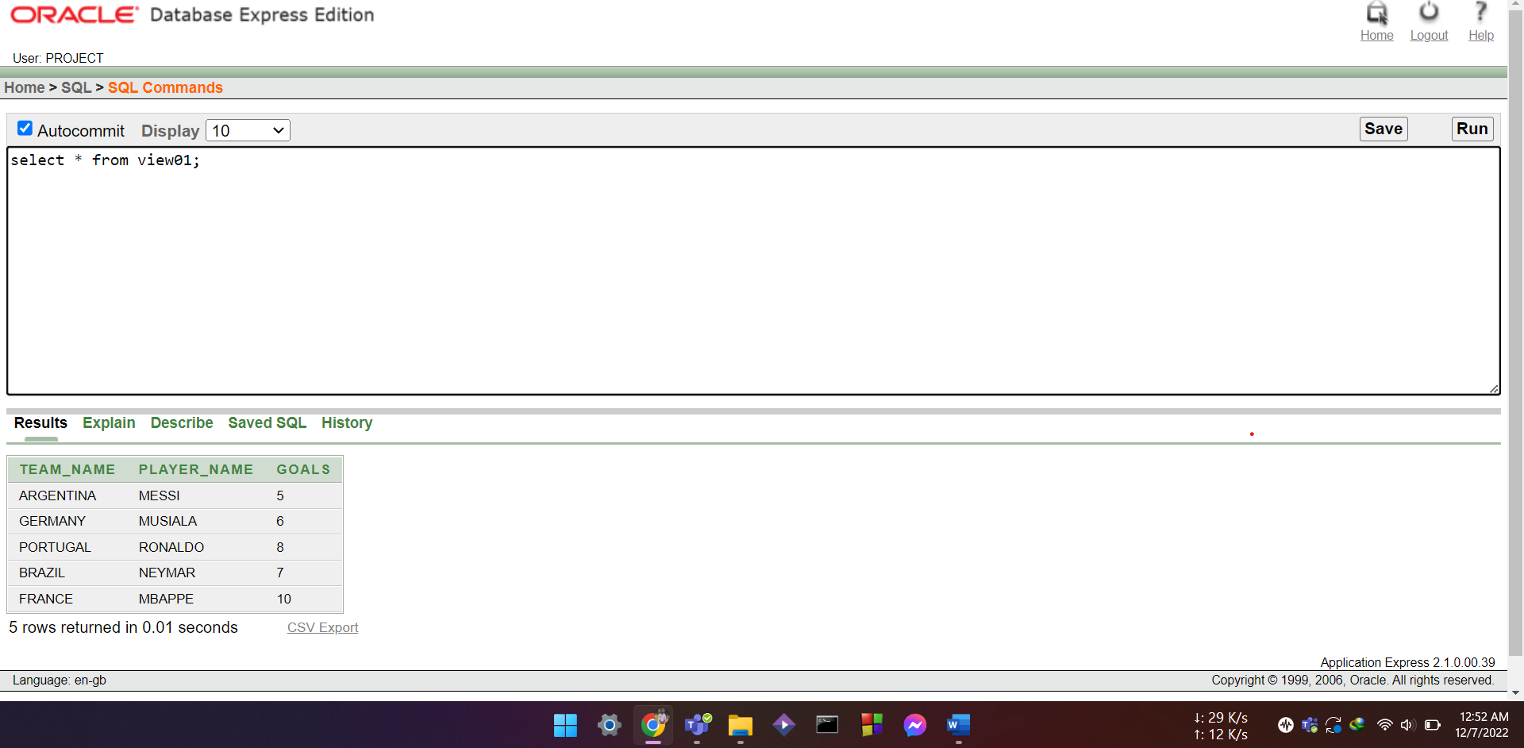
Complex view:
Create a view TEAM1 to show the team name,player name and goal scored of those player who scored maximum goals from each teams
create view view01 as select team.team_name,player.player_name,player_stats.goals from team,player,player_stats where team.team_id=player.team_id and player.player_id=player_stats.player_id and player_stats.goals in(select max(goals) from player_stats group by team_id);

Slide 43
Conclusion & Future work:
In a conclusion, FIFA Football World Cup Management System can help to keep the records of any kind of football tournament. This DBMS can keep records of any kind of information regarding the tournament. If necessary, we can also create more tables in future and also insert new attributes in necessary.
This project gave us the opportunity to implement the skills we learnt during the course. While doing the project we gained deeper understanding on database design and how it can be implemented in real life situations. In future we hope to use the knowledge and skills we gained from this project to implement into making more advanced database management system.

